Slide 1
What to do when inbox DSC Resources don't cover your goal
Creating a RDS Farm using DSC
Ben Gelens, MVP, @bgelens, bgelens.nl DevOps & Cloud Consultant @ InSpark

Slide 2
Agenda
Scenario
Environment
Demo
Summary
Bad Script resource usage examples (if time)

Slide 3
Scenario
Company X creates a lot of RDS farms for their customers in a manual process.
Farms are (without regard to apps) 99% simular.
Task: Automate deployment / configuration

Slide 4
Development Environment
Development has started and VMs are in place:
DC-01 (Domain Controller, already promoted)
CB-01 (RDS Connection Broker)
SH-01 (RDS Session Host)
SH-02 (RDS Session Host)
Notes:
The domain controller is already promoted and the other servers already have roles and features installed and are joined to the domain.

Slide 5
Demo

Slide 6
Summary
DSC Resources are scattered over multiple places. Make sure you have searched before you start creating your own!
Use of Script resource should be limited
It‘s not that hard ☺

Slide 7
Bad Script Resource usage

Slide 8
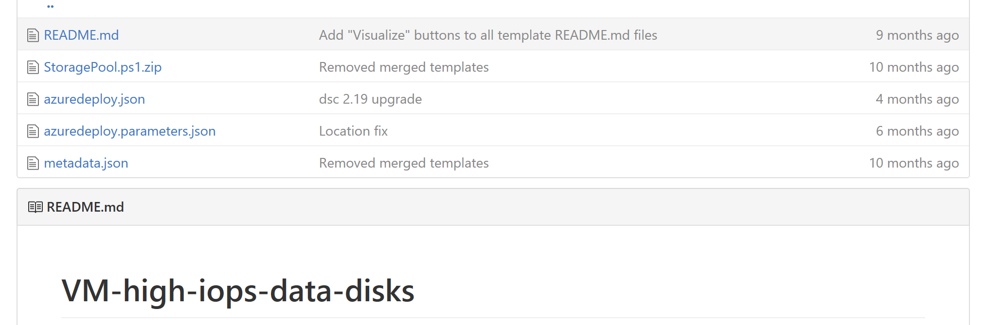
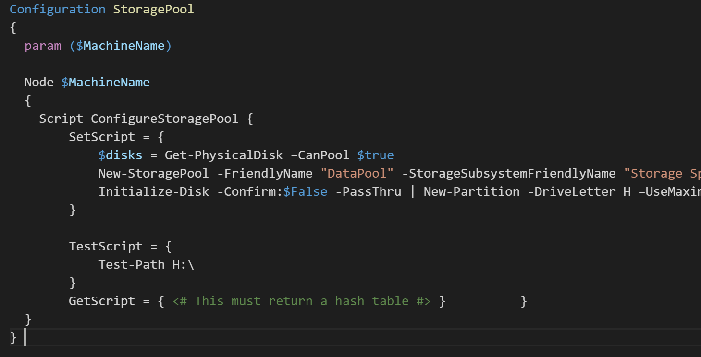
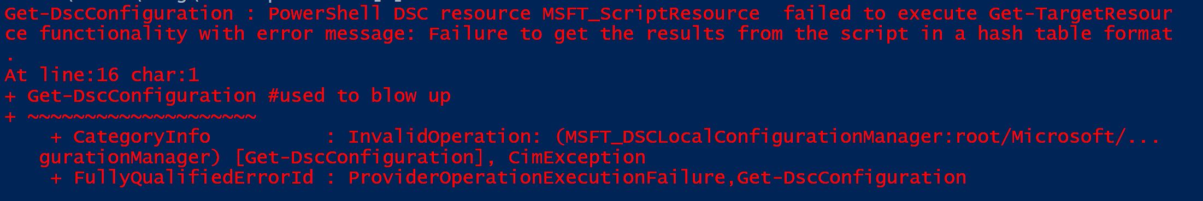

Slide 9
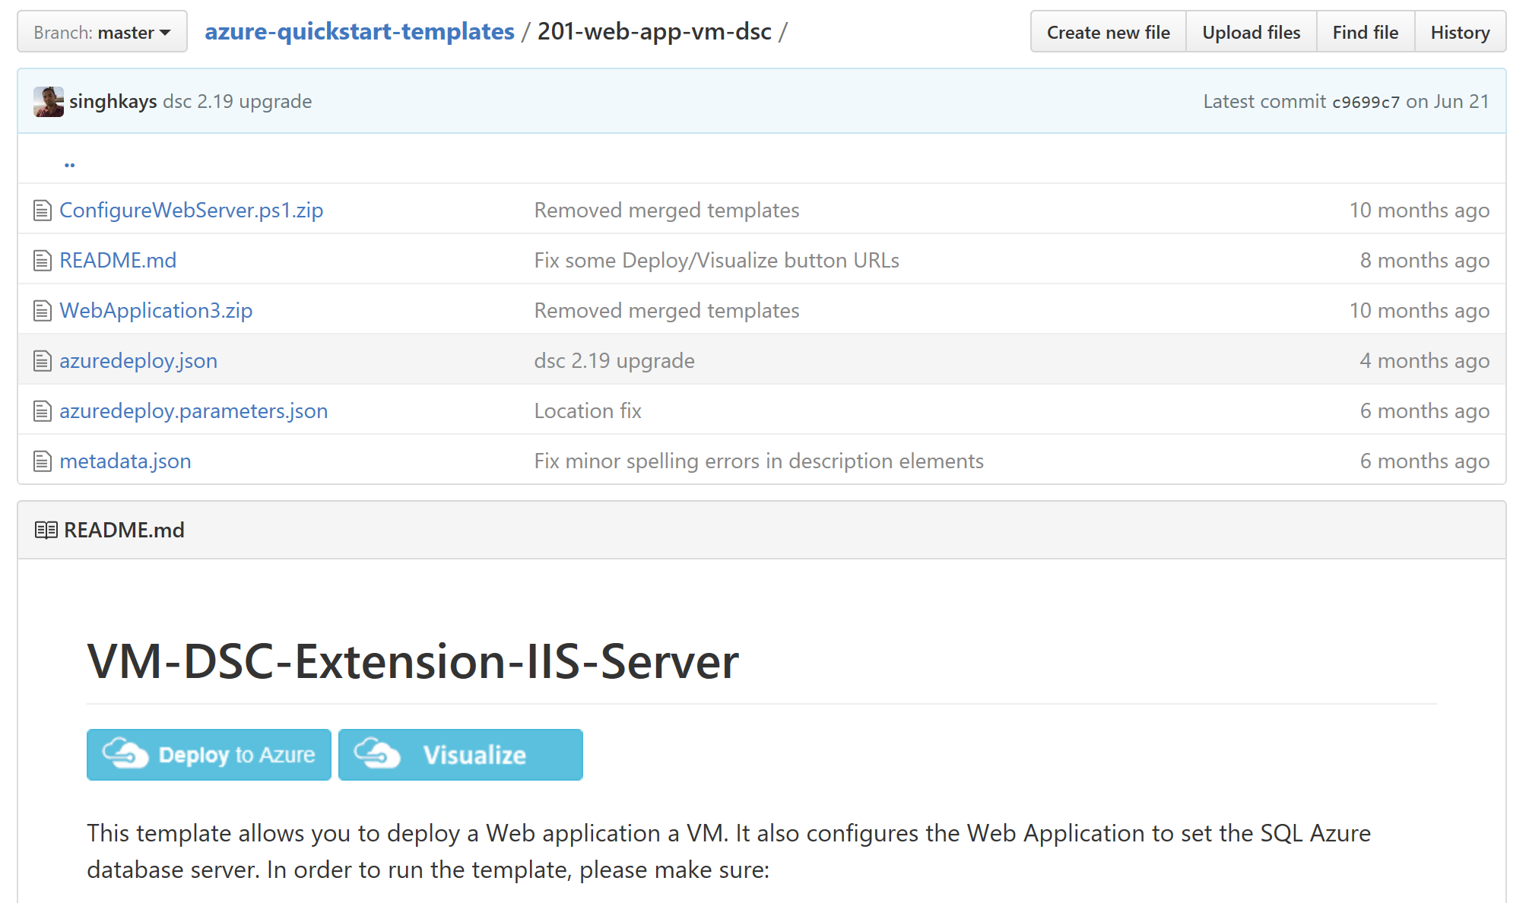
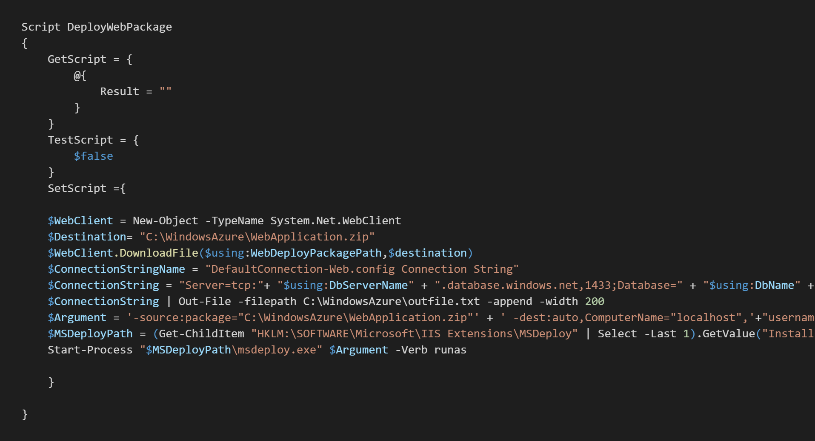
Is this any good?

Slide 10
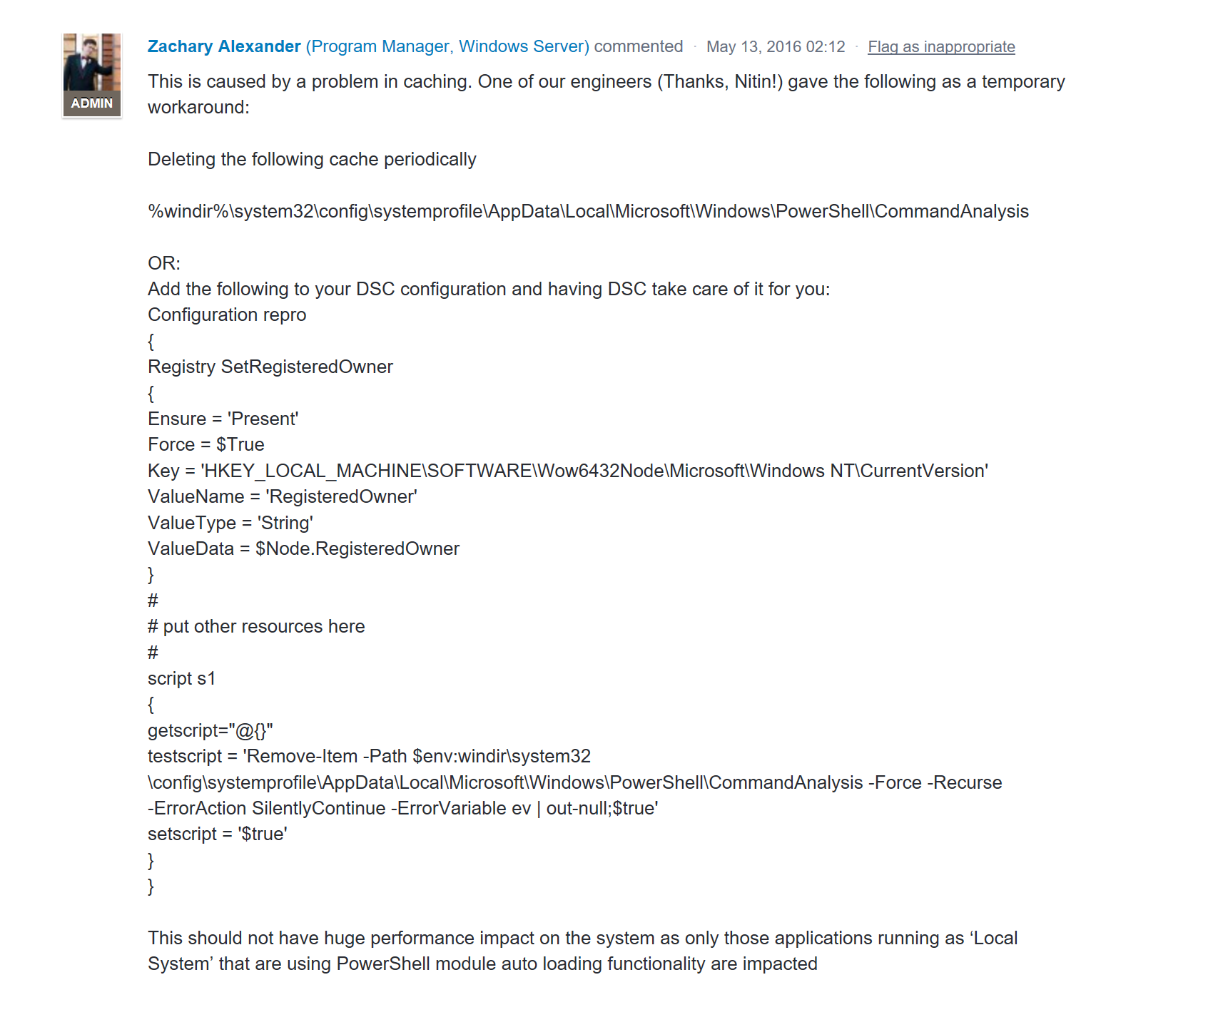
Test == Set?
https://windowsserver.uservoice.com/forums/301869-powershell/suggestions/13703175-get-psdrive-abnormal-i-o

Slide 11
Next Steps...
Now: 15 min break
Grab a coffee
Stay here to enjoy next presentation
Change track and switch to another room
Ask me questions or meet me in a breakout session room afterwards

Slide 12
Questions?

Slide 13
Get-MyInfo
Name : Ben Gelens
Job : Consultant
MVP : CDM (PowerShell)
Company : InSpark
Email : ben@bgelens.nl
Twitter : @bgelens
GitHub : bgelens
Community : {Hyper-V.nu, azurestack.blog, DuPSUG}
Blogging : {bgelens.nl, Hyper-V.nu, PowerShellMagazine.com, azurestack.blog}

